Slide 1


MSIR Model Analysis
Min Young Kim
Juwon Park

Slide 2
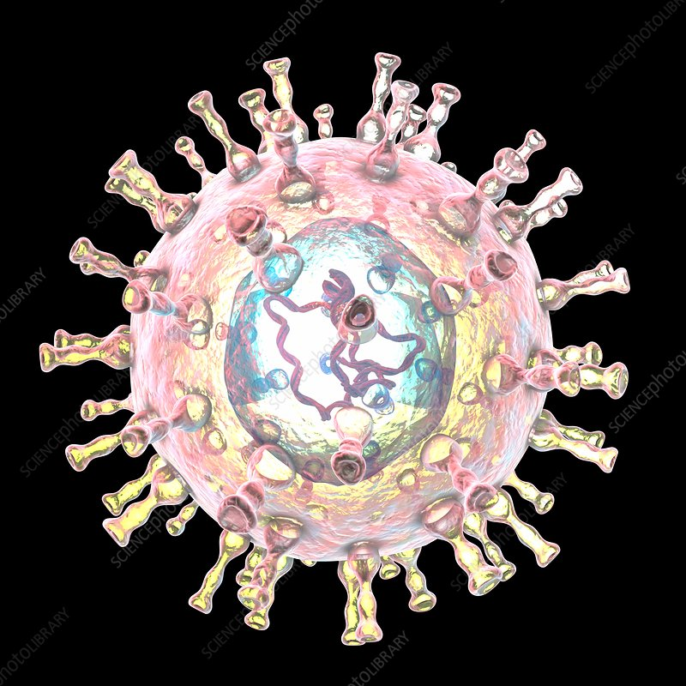
About The Project
Chickenpox (Varicella)
Effect of Passive Immunity
MSIR model
Background
Highly contagious
Common in school age children
Very serious before the vaccine was developed

Slide 3
Modeling Assumptions
Weakness of Model
There should not be people who get other diseases
Ignore change in population due to immigration and emigration
Can never become susceptible again
Constant rate of infectivity
The population is homogeneous
No isolation, No vaccination
Only people can spread disease
Error when apply real world data
MSIR model would not be suitable if the population levels are small

Slide 4
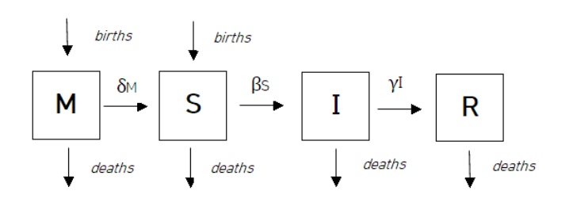
MSIR Model

Slide 5
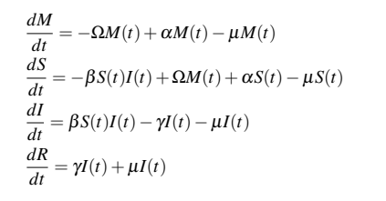
Equation
Birth rate : α
Death rate : μ
Rate of non-passive immune people : Ω
Rate of infectivity : β
Recovery rate : γ

Slide 6
Questions
When is the disease spreading most rapidly?
When is the disease decreasing most rapidly?
On what day did the epidemic reach its peak and what percentage of people were infectious on that day?
What percentage of the population got infectious during the outbreak?

Slide 7
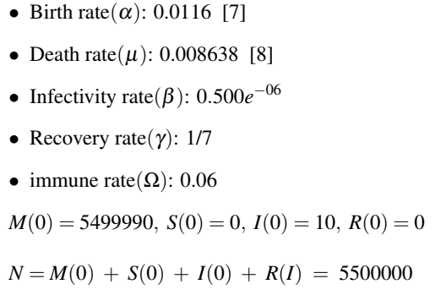
Initial Parameters

Slide 8
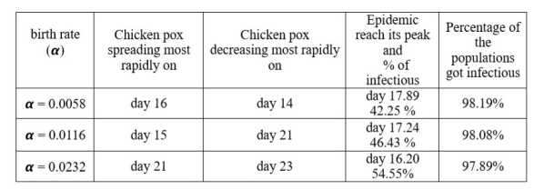
Change in Birth Rate

Slide 9
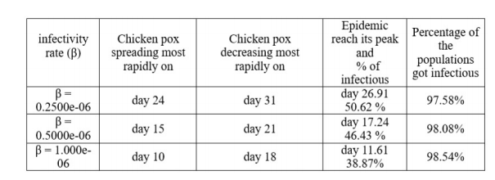
Change in Infectivity Rate

Slide 10
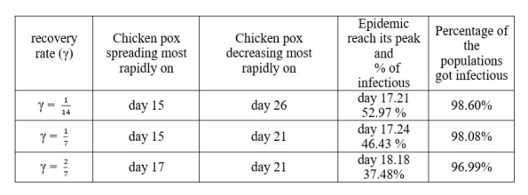
Change in Recovery Rate

Slide 11
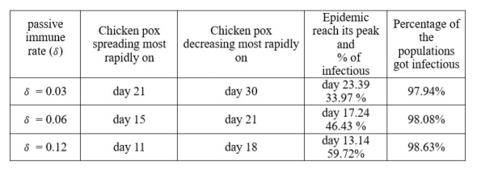
Change in Passive Immune Rate

Slide 12
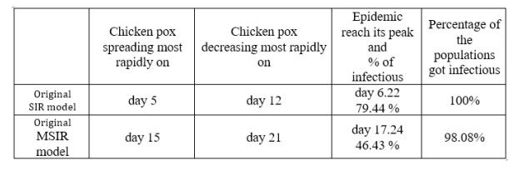
MSIR vs. SIR

Slide 13
CONCLUSION
Passive immune class suppresses the spreading of disease.
Need low birth, infectivity, passive immune rate, and high recovery rate to suppress an epidemic.
Getting a vaccine is important.

Slide 14
FUTURE WORK
SIR model with vaccination or SIR model with isolation.
Passive immune vs. vaccination or isolation
MSIR model with vaccination or isolation

Slide 15

THANK YOU!

